Slide 1
Java working with databases
Accessing a relational database using JDBC

Slide 2
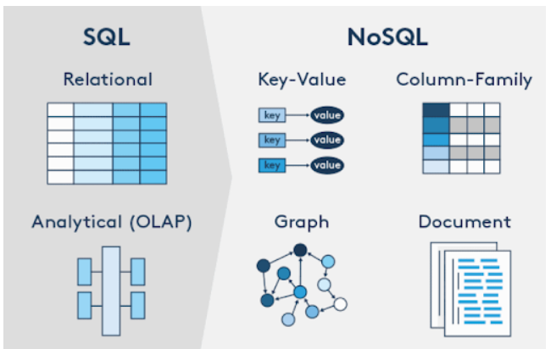

Type of databases

Slide 3
Java technologies to access databases
JDBC (Java Database Connectivity): It's a standard Java API for database-independent connectivity between the Java programming language and a wide range of databases.
Hibernate: An open-source Object-Relational Mapping (ORM) framework that simplifies database access by converting Java objects into database tables and vice versa.
JPA (Java Persistence API): It's a specification that describes the management of relational data in applications using Java Platform, Standard Edition, and Java Platform, Enterprise Edition. Hibernate can be used as a JPA implementation.
Spring Data JPA: It simplifies the implementation of JPA based repositories by reducing boilerplate code. It's a part of the larger Spring Framework.
Spring JDBC: The Spring JDBC module provides a JDBC-abstraction layer that removes the need to do tedious JDBC coding and parsing of database-vendor specific error codes.
MyBatis: An open-source, lightweight persistence framework that removes almost all of the JDBC code and sets the parameters and gets the results.
JOOQ (Java Object Oriented Querying): It implements the active record pattern. Its purpose is to be both relational and object-oriented by providing a domain-specific language to construct queries from classes generated from your database.
EclipseLink: It's an open-source ORM solution for Java EE and Java SE platforms. EclipseLink supports a number of persistence standards including JPA, JAXB, JCA and SDO.
Apache Cayenne: An open-source persistence framework providing object-relational mapping (ORM) and remoting services.
Querydsl: It's a framework which enables the construction of statically typed SQL-like queries via its fluent API.

Slide 4
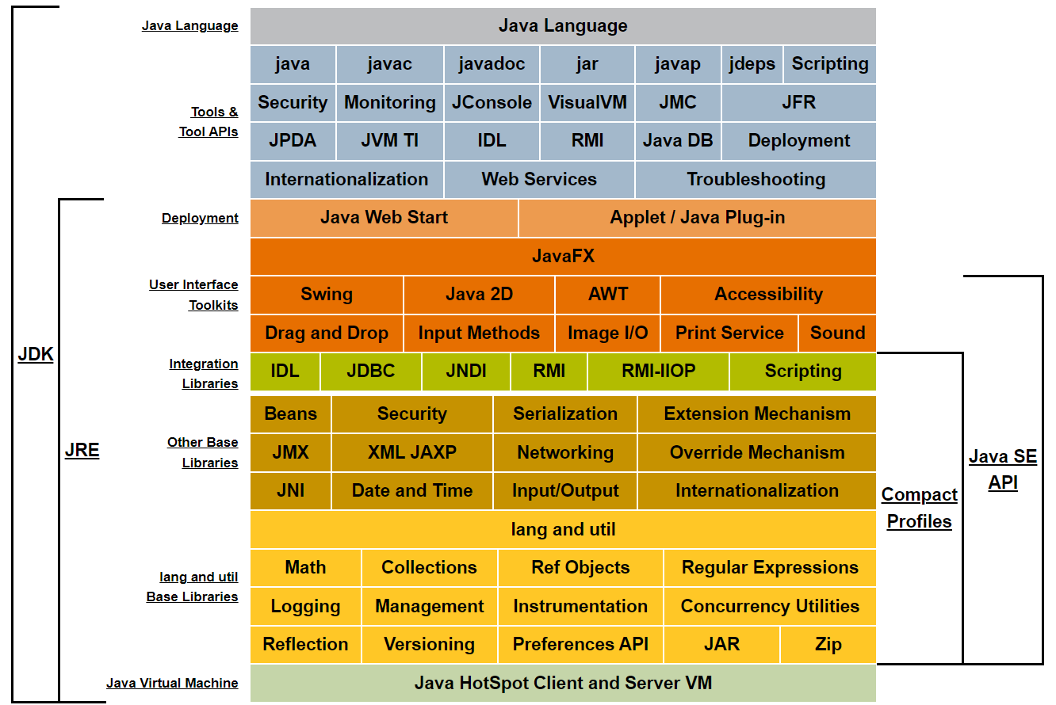
JDBC (Java Database Connectivity)
Jave SE Platform at a Glance
https://docs.oracle.com/javase/tutorial/jdbc/basics/index.html

Slide 5
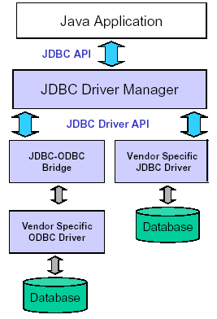
JDBC
Java Database Connectivity
Database Access Interface
provides access to a relational database (by allowing SQL statements to be sent and executed through a Java program)
JDBC package: set of Java classes that facilitate this access (java.sql.*)
Comes with JDK (since 1.1)

Slide 6
JDBC Driver
Need a driver, specific to the DB product, to mediate between JDBC and the database
the driver is a Java class that needs to be loaded first
Java Program
- load driver
- establish connection
- send SQL statements
Relational
DBMS
Type IV driver is the most easy to use
Client
Application
Driver (Type IV)
Database Specific Protocol
Database

Slide 7
Key Classes in JDBC
Connection
need to create an instance of this class when establishing a connection to the database
Statement
for issuing SQL statements
ResultSet (interface)
a ResultSet object represents the table returned by an SQL select statement
DriverManager
Creates
Connection
Creates
Statement
Creates
Result Set
Driver
Established
Link to DB
Database

Slide 8
Establishing a Connection
Use the getConnection() method
under the DriverManager class
String argument: "jdbc:driver:name”
returns a Connection object
1. Class.forName(“sun.jdbc.odbc.JdbcOdbcDriver”);
// above line loads the jdbc-odbc driver
String dbname = “jdbc:odbc:MyDB”;
2. Connection c = DriverManager.getConnection(dbname);

Slide 9
Creating a Statement Object
Execute the createStatement() method on the Connection object
returns a Statement object
afterwards, run methods on the Statement object to execute an SQL statement
Statement s = c.createStatement();

Slide 10
Methods of the Statement Class
Methods of the Statement class require a string parameter containing the SQL statement
executeQuery()
requires a String argument (a SELECT statement)
returns a ResultSet object representing the table returned
executeUpdate()
requires a String argument (an INSERT, UPDATE, or DELETE statement)
returns an int (row count, in most cases)

Slide 11
The ResultSet Interface
A ResultSet object represents the table returned by the select statement sent
Navigation/retrieval methods
next(): moves to the next row (first row if called for the first time), returns false if no rows remain
getXXX() methods return the value of a field for the current row

Slide 12
ResulSet example
Need braces because
ORDER is a reserved
word in SQL
ResultSet rs;
rs = s.executeQuery(“SELECT * FROM [ORDER]”);
rs.next(); // gets the first row (use in a loop for multiple rows)
// suppose the ORDER table has an integer field
// called quantity
int myvar = rs.getInt(“quantity”);
// if you knew that quantity is the 2nd field in the table
myvar = rs.getInt(2);

Slide 13
executeQuery( ) example
…
Statement s = con.createStatement();
ResultSet rs = s.executeQuery( “SELECT * FROM STUDENT WHERE QPI > 3.0” );
while ( rs.next() )
{ String name = rs.getString(“LastName”); int y = rs.getInt(“Year”); double qpi = rs.getDouble(“QPI”); System.out.println( name + “ ” + y + “ ” + qpi);
}

Slide 14
executeUpdate( ) example
…
Statement s = con.createStatement();
int result;
result = s.executeUpdate( “DELETE FROM EMPLOYEE WHERE DeptCode=‘CS’” );
System.out.println( result + “ rows deleted.” );

Slide 15
The PreparedStatement class
PreparedStatement: a Statement that specifies parameters through Java code
The SQL statements take different forms when you specify different parameter values
Useful when query is performed repeatedly
Formatting of literal values is easier

Slide 16
Version 1 (Statement)
// suppose lastName is a String variable
Statement s = con.createStatement();
ResultSet rs = s.executeQuery(
“SELECT * FROM STUDENT WHERE LastName = ‘” + lastName +”’” );
while ( rs.next() )
{ String name = rs.getString(“LastName”) + rs.getString(“FirstName”); int y = rs.getInt(“Year”); double qpi = rs.getDouble(“QPI”); System.out.println( name + “ ” + y + “ ” + qpi);
}
Query string is built manually

Slide 17
Version 2 (PreparedStatement)
// suppose lastName is a String variable
PreparedStatement s = con.prepareStatement( “SELECT * FROM STUDENT WHERE LastName = ?” );
s.setString( 1, lastName );
ResultSet rs = s.executeQuery();
while ( rs.next() )
{ String name = rs.getString(“LastName”) + rs.getString(“FirstName”); int y = rs.getInt(“Year”); double qpi = rs.getDouble(“QPI”); System.out.println( name + “ ” + y + “ ” + qpi);
}
the appropriate literal is “inserted” in the query

Slide 18
Summary
JDBC allows you to write Java programs that manipulate a database
A driver (often a separate product) is required that facilitates access
Key classes: Connection, Statement, PreparedStatement, and ResultSet
Other features: metadata and stored-proc invocation

